Slide 1
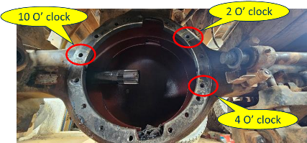
18TG axle casing crack at 2 O clock & 10 O clock - Meritor
Complaint / Problem details |  | Axle casing crack at 2 O clock, 4 O clock & 10 O clock in 3525 Bogie tipper fitted with MT15i 18TG axle |  |  |  | Issue status | RL3
 |  |  |  |  |  | Issue grade | 3
Model |  | 3525T | Failure Kms | 1943 Hrs |  | Data as on | Aug’23
Mfg plant |  | PNR | No of cases | MT15i 18TG - 1 |  | Resp | Meritor
Observation/ Root cause | Observation / Analysis 1st failure of 18TG axle casing crack in RA2 at 2 O clock, 4 O clock & 10 O clock reported in 3525 BGS tipper vehicle Vehicle is operating in Kakinada. Application: Boulders / M. Sand from Quary taken to Kakinada port Lead distance: 4 kms (Quary to crusher), 140kms (Quary to Kakinada port) Vehicle is fitted with 38T Suspension (Not modified) Vehicle attended for Drive head joint leak complaint at 980 Hrs. It was observed shorter bolt (16TG) used during the attention Failed material analysis under progress at Meritor. T: Sep’23 |  | Photos / Illustration |  | Illustration
 |  |  |  |  | v
Action | Under analysis . T: 15.09.2023
Notes:
Content Slide

Slide 2
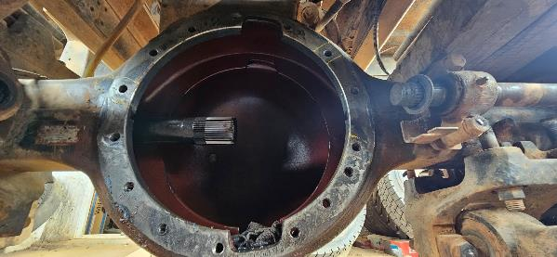
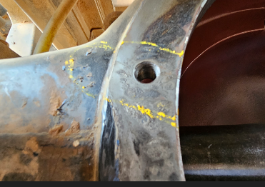
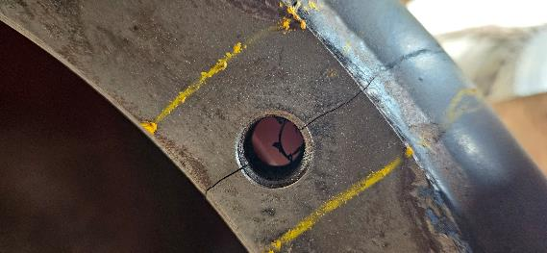
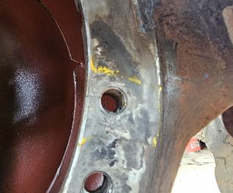
18TG RA2 axle casing crack in 3525 Tipper Failure photographs
10 O’ clock
2 O’ clock
Crack locations
4 O’ clock
10 O’ clock
2 O’ clock
4 O’ clock

Slide 3
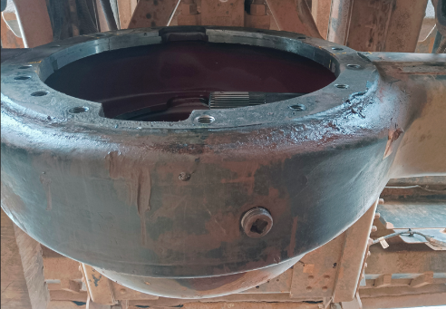
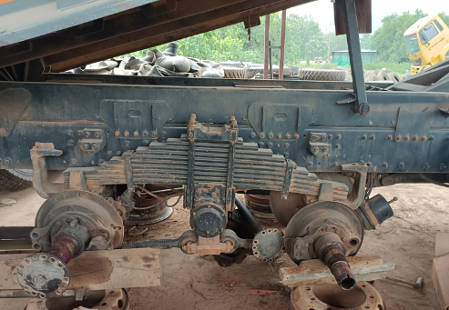
18TG RA2 axle casing crack in 3525 Tipper Failure photographs
External rubbing mark observed
Leaf spring – 38T

Slide 4

Notes:
End slide

Slide 5
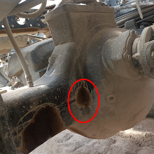
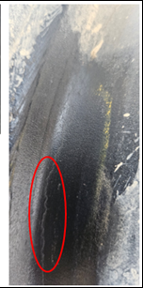
18TG axle casing crack at Dome weld area - Meritor
Complaint / Problem details |  | Axle casing crack at Dome weld area in 2825 Bogie tipper fitted with MT15i 18TG axle |  |  |  | Issue status | RL3
 |  |  |  |  |  | Issue grade | 3
Model |  | 2825T | Failure Kms | 668 Hrs |  | Data as on | Aug’23
Mfg plant |  | PNR | No of cases | MT15i 18TG - 1 |  | Resp | Meritor
Observation/ Root cause | Observation / Analysis 1st failure of 18TG axle casing crack at Dome weld area reported in 2825 BGS tipper vehicle Vehicle is operating in Marur site (Trichy). Application: River sand excavation from the river and bringing out and dumping in yard. Lead distance: 4 kms (one side), 15 trips / 130kms operated per day. Vehicle is operating in River bed Vehicle is fitted with 30T Suspension (Field modified) Failed material analysis carried out at Meritor & AL MED. It is observed that Dome weld hardness is lower than the Dome material hardness. Dome inner side Weld bead shift observed in failed sample. Also weld penetration is more towards Dome cover and penetration is not within spec for Housing side |  | Photos / Illustration |  | Illustration
 |  |  |  |  | v
Action | Interim action: For Detection of bead shift, 100% visual check of weld bead leg length both at Cover and housing side near gear slot area will be inspected. C: 02.09.2023 Negative validation to be carried out to validate the bead shift. T: 12.09.2023
Notes:
Content Slide

Slide 6
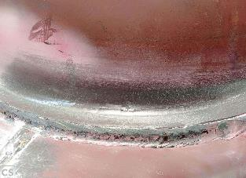
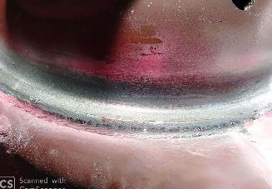


Dome radius crack observations
Fig 1: RH-Shorter side
Fig 2: LH-Longer side
Before DP test
RH-Shorter side: The longitudinal crack has visible at 2 to 3 O’clock position on the outer side dome radius and weld lump and ground mark also observed shown in fig 1.
LH-Longer side: crack has invisible at 9 to 10 O’clock position shown in fig 2.
Fig 3: RH-Shorter side
Fig 4: RH-Shorter side
After DP test
RH-Shorter side: The longitudinal crack has visible at 2 to 3 O’clock position on the outer side dome radius as shown in fig3 .
LH-Longer side: Longitudinal crack has visible during dye penetrant test outer and inside dome radius at inside dome toe at dome side shown in fig 4

Slide 7
Notes:
End slide

Slide 8
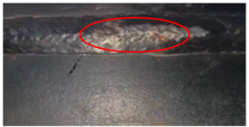
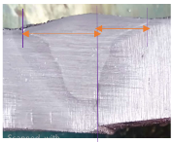
18TG axle casing crack at Seam weld area - Meritor
Complaint / Problem details |  | Axle casing crack at Seam weld area in 3525 Bogie tipper fitted with MT15i 18TG axle |  |  |  | Issue status | RL3
 |  |  |  |  |  | Issue grade | 3
Model |  | 2825T & 3525T | Failure Kms | 1307 Hrs & 1956 Hrs |  | Data as on | Aug’23
Mfg plant |  | PNR | No of cases | MT15i 18TG - 2 |  | Resp | Meritor
Observation/ Root cause | Observation / Analysis 1st failure of 18TG axle casing crack at Seam weld area reported in 3525 BGS tipper vehicle at Polavaram (AP). Field Joint investigation carried out and following are the findings Vehicle is operating at Polavaram irrigation project site Vehicle is fitted with 30T Suspension (Field modified) Application details Operating load : Onward – Wet sand, Return - Empty Lead distance : 12 Kms LR category : L4R4 / L5R4 Vehicle operation : 24x7 (2 Shifts) Vehicle is operating in River bed site with Approx. GVW of 62T. Failed part under analysis done and Weld bead shift observed i.e., Weld presence witnessed more on one half of the Housing |  | Photos / Illustration |  | Illustration
 |  |  |  |  | v
Action | Interim action: 18TG Seam welding to be carried out in Robo welding which has weaving feature (side-to-side motion of the weld wire, resulting in enhanced fusion of the weld). T: 16.09.2023 Long Term: Current Seam Weld machine to be upgraded with Weaving option. T: Oct’23
Notes:
Content Slide

Slide 9
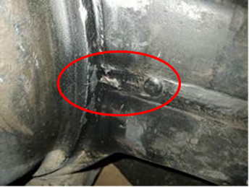
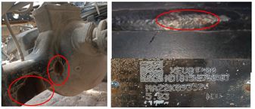
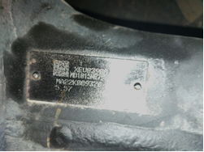
Field Issue / Defective Part/Veh. Summary
Issue Desc: | Axle casing seam weld crack in MT15i 18TG model
Supplier: | M/s Meritor |  | Issue Dt/Month: | Aug’23 (SQ Recd)
Part Desc: | MT15i 18TG axle / Casing | Veh Model: | 2825 & 3525 Tipper Bogie tipper | Rej Qty: | 2 Nos
Remarks: | Repeat failure / 2nd case of seam weld area and dome radius crack in 18TG
Defect Picture (Part/Vehicle):
Chassis | MB1H3VLD3NRBD5277
Veh model | 2825 Bogie tipper
RAR | 5.57
DOS | 24-Jan-23
DOF | 24-Aug-23
Failed Hrs | 1200 Hrs
Axle make & Model | Meritor, MT15i 18TG
Axle S.No | MA22K089376
Location | Karur
Customer name | M/s SR Infra

Slide 10
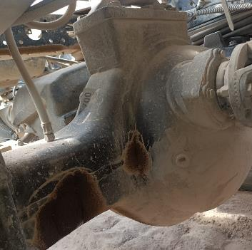
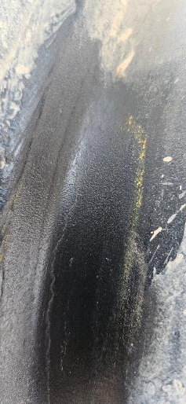
18TG RA1 axle casing crack in 3525 Tipper Failure photographs
RA1 – Dome radius crack at 9 O’ clock position
RA1 – Seam weld crack on long side
S.No | Service history | Date
1 | Clutch disc & cover assy | 9th Mar’23
2 | 10th leaf modification | 12th Apr’23
3 | Bogie wear pad | 12th Apr’23

Slide 11
Notes:
End slide

Slide 12
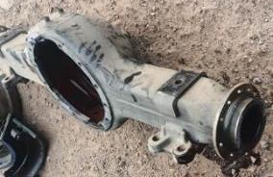
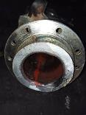
Friction weld crack - Meritor
Complaint / Problem details |  | Friction weld crack in model fitted with Meritor Q109, MT15i (16TG) & MT15i (18TG) axle models |  |  | Issue status | RL4
 |  |  |  |  | Issue grade | 5
Model |  | Ecomet 1615, 2820T, 4825T, 3525 T | Failure Kms | Ecomet: 495 Kms, 12595 Kms, 13589 Kms 6x4T: 1510 Hrs, 10x4T: 3220 Hrs, 8x4T: 103 Hrs | Data as on | Aug’23
Mfg plant |  | H2 & Alwar | No of cases | 6 (Q109 - 3, MT15i 16TG – 2, MT15i 18TG - 1) | Resp | Meritor
Observation/ Root cause | Observation / Analysis 6 cases of Friction weld crack failure reported in Meritor fitted axle models. During earlier analysis, Widmanstatten microstructure observed in Material which was formed with faster cooling rate & reduce the impact strength. Hence water cooling eliminated & Forced fan cooling system introduced. Now, after cut off failures reported Following are the observation in failed sample: Crack initiated in Friction weld bonding line at 6 O Clock position Material & microstructure meets Meritor specification. As Meritor could not able to conclude root cause with failed sample analysis, Meritor has done negative validation on new axle (Sample size: 5) to establish the root cause & below are the outcome Micro crack observed on all the samples with more number of iterations (>20) during bend removal process. In current process, No. of stroke is not defined to achieve straightening and No record on iterations available against each Housing S.No DP test not effective to identify the Pre-existing crack Meritor in discussion with Global weld expert towards improvements on Weld parameters and quality. T: Sep’23 Weld flaw detection: Ultrasonic / Eddy current flaw deflector is being evaluated to detect the weld flaws. T: Jan’24 |  | Photos / Illustration |  | Illustration
 |  |  |  |  | v
Action | Meritor introduced Poka-Yoke for straightening process. If the No. of iterations goes beyond 20, the RAM function will be stopped automatically. Implemented in Bay 1 & 2 from 7-08-23. Bay 4 - C: 01-09-23 Temperature checking interlock will be provided at last station of Forced air cooling. Under implementation. T: 15.09.23
Notes:
Content Slide

Slide 13
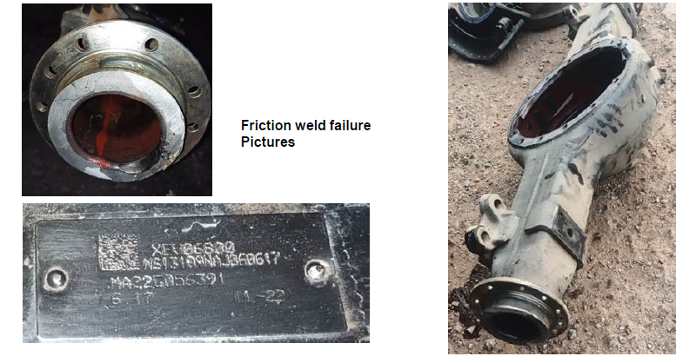
Failure photographs
Notes:
Content Slide

Slide 14
Notes:
End slide

Slide 15
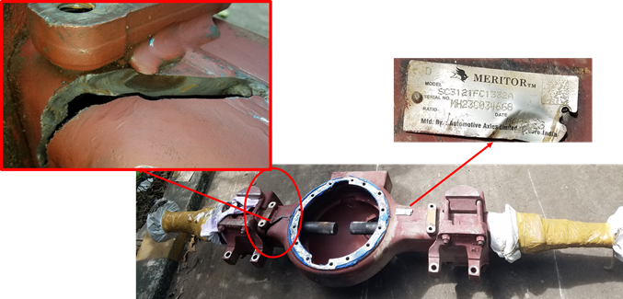
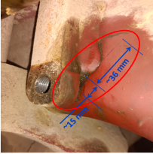
18TG axle casing crack at S Cam pad weld area – Field retro fitted casing Meritor
Complaint / Problem details |  | Axle casing crack at S Cam pad weld area in 2825 Bogie tipper fitted with MT15i 18TG axle |  |  |  | Issue status | RL3
 |  |  |  |  |  | Issue grade | 3
Model |  | 2825 Bogie Tipper | Failure Kms | 857 Hrs – 1204 Hrs |  | Data as on | Aug’23
Mfg plant |  | H2 | No of cases | MT15i 18TG - 6 |  | Resp | Meritor
Observation/ Root cause | Observation / Analysis 6 Cases reported in 18TG axle casing so far. (Field replaced / SPD axle) Crack initiated from S Cam pad weld and progress towards seam weld area. Meritor assy. Line, as per earlier layout (with no time delay) after S Cam pad welding next process will be machining operation with coolant intact chances of Housing HAZ will be higher. Hence 4 mins delay introduced between Cam pad welding and Cam pad wet machining process There is no Drive head mounting joint leak/bolt loosening is observed in this vehicle which was highlighted as one of the potential stress raiser at the S-cam pad area The suspension bolts were checked for its tightness and found Ok It was observed that S Cam pad weld width found irregular and non-uniform Both vehicles are operating in Marur site (Trichy). Application: River sand excavation from the river and bringing out and dumping in yard. Lead distance: 4 kms (one side), 15 trips / 130kms operated per day. Vehicle is operating in River bed Case 1 ,2 & 3 analyzed and below are findings. Other sample are in transit. T: Sep’23 Weld penetration found less than spec in failed sample |  | Photos / Illustration |  | Illustration
 |  |  |  |  | v
Action | Interim action: - To ensure no cold start at stress zone, welding direction of the bracket shifted to Top - bottom side instead of Bottom – top side. Supplier cut off: 27.08.2023 Permanent action: - Robo welding being explored by Meritor. Under discussion with US expert team and Feasibility will be declared. T: End Oct’23
Case 1
Case 2
Notes:
Content Slide

Slide 16
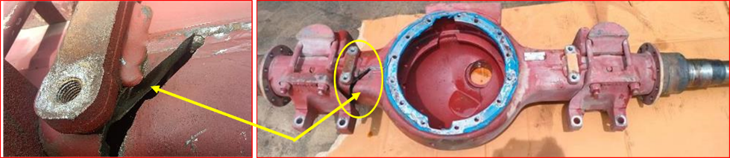
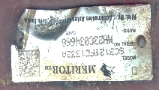
Field Issue / Defective Part/Veh. Summary
Issue Desc: | 18TG RA1 Axle casing broken at Spring seat/S.Cam brkt weld area
Supplier: | Meritor-Automotive Axles Ltd |  | Issue Dt/Month: | 18.07.23 / Jul’23
Part Desc: | 18TG RA1 Axle / Housing | Veh Model: | 2825-Tipper | Rej Qty: | 10+ Nos
Remarks: | All fractures on cam pad weld are associated with retrofitted axles in field only.
Defect Picture (Part/Vehicle):

Slide 17
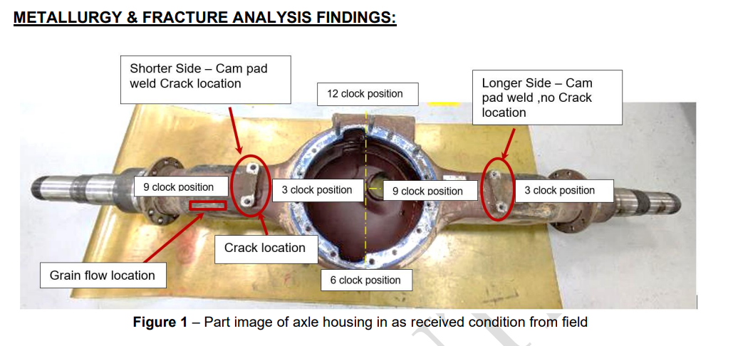
Defective Part - Preliminary Analysis / Observation’s

Slide 18
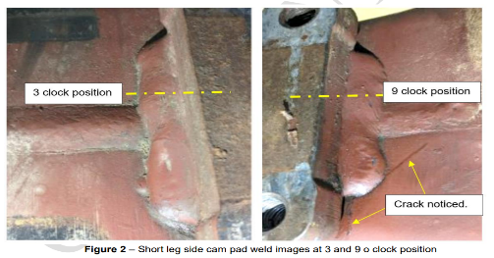
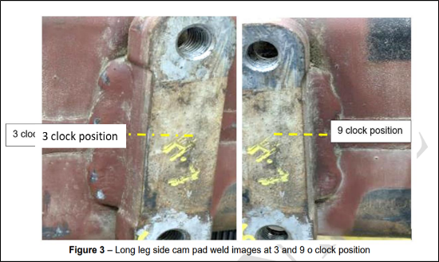
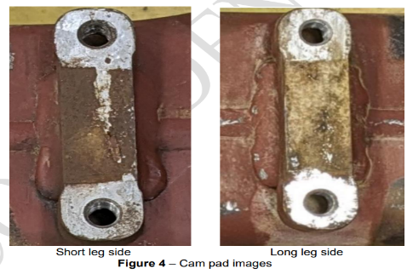
Defective Part - Preliminary Analysis / Observation’s

Slide 19
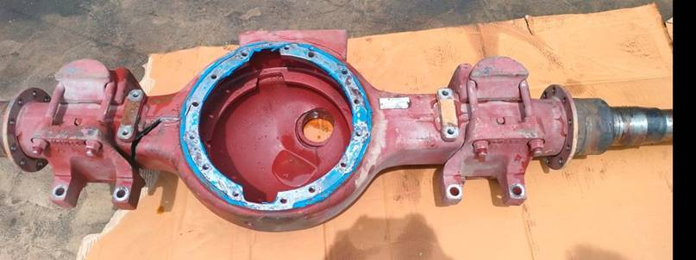
Case 1 – 18TG axle casing crack at S Cam pad weld area
Activity | Date of Failure | Hours | Remarks
RA1 16TG Housing replaced | 04-06-2022 | 288 | RA1 Axle casing crack @ LHS box section area
14 leaf bogie trail fitment | 24-08-2022 | 505 | Trial fitment of 28.8T spring
RA2 16TG Housing replaced | 07-12-2022 | 925 | RA2 Axle casing crack at 10 O’ clock position
RA1 18TG replaced against 16TG failure | 23-03-2023 | 1461 | RA1 Axle housing cracked @ 4 O’ clock position
RA 1 18 TG Failed Hrs | 15-07-2023 | 2557 | RA1 Axle casing crack at S cam pad weld area
Hours covered with 18 TG |  | 1096

Slide 20
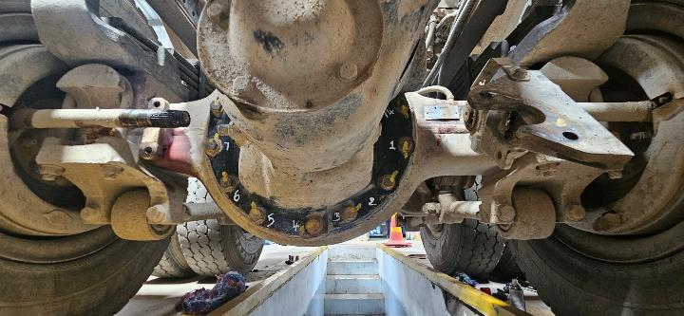
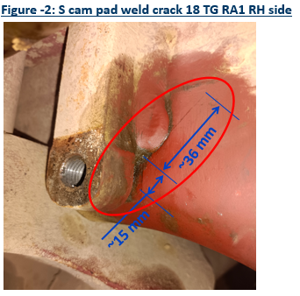
Case 2 – 18TG axle casing crack at S Cam pad weld area
Activity | Date of Failure | Hours | Remarks
RA1 16TG Housing replaced | 27-03-2023 | 1163 | RA1 Axle casing crack @ 4 O’ clock position
14 leaf bogie trail fitment | 03-03-2023 | 1157 | Suspension modification 5th & 8th removal
RA 1 18 TG Failed Hrs | 18-07-2023 | 2020 | RA1 Axle casing crack at S cam pad weld area
Hours covered with 18 TG |  | 857

Slide 21
Notes:
End slide

